Slide 1
Integrating GIS and BI: a Powerful Way to Unlock Geospatial Data for
Decision-Making
Professor Yvan Bedard, PhD, P.Eng.
Centre for Research in Geomatics
Laval Univ., Quebec, Canada
National Technical University of Athens
Mai 27th, 2011

Slide 2
Origins
Organisations worldwide invest hundreds of millions of dollars annually to acquire large amounts of data about the land, its resources and uses
These data however prove difficult to use by managers who need:
  aggregated information - trends analysis
  spatial comparisons - space-time correlations
  fast synthesis over time - unexpected queries
  interactive exploration - crosstab analysis
  geogr. knowledge discovery - hypothesis dev.
  etc.

Slide 3
Barriers to make analysis with transactional systems
GIS and DBMS design are transactional by nature
  Oriented towards data acquisition, storing, updating, integrity checking, simple querying
Transactional databases are usually normalized so duplication of data is kept to a minimum :
  To preserve data integrity and simplify data update
A strong normalization makes the analysis of data more complex :
  High number of tables, therefore high number of joins between tables (less efficient).
  Long processing time
  Development of complex queries

Slide 4
Analytical approach vs transactional approach
No unique data structure is good for BOTH managing transactions and supporting complex queries. Therefore, two categories of databases must co-exist: transactional and analytical (E.F. Codd).
Example of co-existence: one source -> several datacubes
Source
Read-only
Analytical
Data cubes
Legacy
transactional
database
ETL
Restructured
& aggregated
data

Slide 5
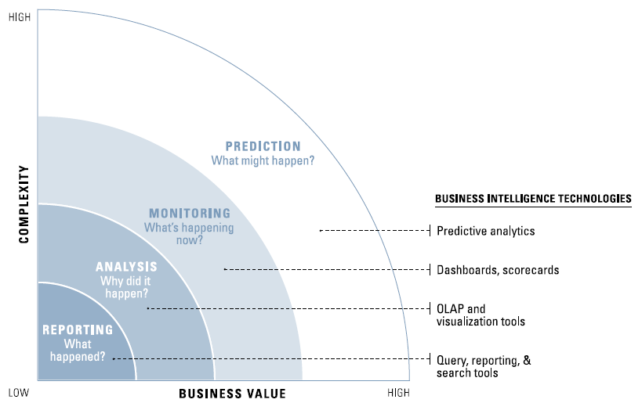
BI Market
Business Intelligence exists since the early 1990s and its market is larger that the GIS market.
However, it didn’t address spatial data until recently. BI and GIS evolved in different silos for many years.
Eckerson, 2007

Slide 6
Today’s Level of Integration
Integrating GIS and BI is a recent field with a lot of potential
Spatially-enabling BI is becoming more common
Larger smiley = more has been achieved
Larger lightning = more difficult challenge

Slide 7
Historical Epochs
1996-2000: pionneering
  early prototypes in universities
    Laval U. - Simon Fraser U. - U. Minnesota
2001-2004: early adopters
  advanced prototypes in universities
  first applications in industry
2005-... : maturing
  larger number of ad hoc applications
  SOLAP technologies to facilitate the
  development of SOLAP applications
2010-…: wide adoption
  0ver 30 commercial products

Slide 8
Analytical System Architectures
(ex. standard data warehouse)
OLAP
Dashboards
Reporting
Legacy OLTP
systems
DW
Datamarts

Slide 9
Analytical System Architectures
(ex. without data warehouse)
Legacy transactional
databases
Datacubes

Slide 10
Datacube Concepts
Dimension = axis of analysis organized hierarchically
Hypercube = N dimensions
Cube = casual name = hypercube
Ex: a Time dimension
All years
Members
2008
2009
2010
Years
Levels
Months
Days
1/4

Slide 11
Datacube Concepts
Members = independant variables
Measures = dependant variables
Dimension 1 (ex. balanced)
Dimension 2 (ex. simpler)
Dimension N
(ex. N:N paths)
Measures
(ex. sales)
Dimension 3 (ex. unbalanced)
Dimension 4 (ex. inconsistent)
2/4

Slide 12
Datacube Concepts
Cube (hypercube) = all facts
A "sales" data cube
Fact: each unique combination of fine-grained or aggregated members and of their resulting measures
Ex.: sold for 2M$ of blouses in Ottawa in 2010
Ex. : sold for 8M$ of pants in Ontario in 2010
A "sales territory" dimension
Montreal
Quebec
Levis
2M
Toronto
1M
2M
2M
3M
3M
Ontario
2M
1M
2M
2M
2M
3M
Ottawa
2M
2008
1M
1M
2M
2009
A "time" dimension
2010
blouses
jeans
kakis
Item level
Provinces
Cities
shirts
tops
pants
Category level
A "product" dimension
3/4

Slide 13
Datacube Concepts
Data structures (MOLAP, ROLAP, HOLAP):
  Multidimensional (proprietary)
  Relational implementation of datacubes
    Client tool provides the multidimensional view
      Star schemas, snowflake schemas, constellation schemas
  Hybrid solutions
Query languages:
  SQL = standard for transactional database
  MDX = standard for datacubes

Slide 14


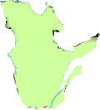
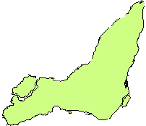

Spatial Datacube Concepts
Spatial dimensions
Non-geometric spatial dimension
Mixed spatial dimension
Geometric spatial dimension
Canada
Canada
…
CB
Québec
NB
…
…
Montréal
Québec
…
…
…
N.B. more concepts exist
2/3

Slide 15
Spatial Datacube Concepts
Spatial measures
Metric operators
Distance
Area
Perimeter
…
Topological operators
Adjacent
Within
Intersect
…
Spatial dimension 1
Spatial dimension 2
N.B. more concepts exist
3/3

Slide 16
Spatial Datacube and SOLAP
Spatial OLAP (On-Line Analytical Processing)
SOLAP is the most widely used tool to harness the power of spatial datacubes
  It provides operators that don’t exist in GIS
SOLAP = generic software supporting rapid and easy navigation within spatial datacubes for the interactive exploration of spatio-temporal data having many levels of information granularity, themes,
epochs and display modes which are
synchronized or not: maps,
tables and diagrams

Slide 17
Characteristics of SOLAP
Provides a high level of interactivity
  response times < 10 seconds independently of
    the level of data aggregation
    today's vs historic or future data
    measured vs simulated data
Ease-of-use and intuitiveness
  requires no SQL-type query language
  no need to know the underlying data structure
Supports intuitive, interactive and
synchronized exploration of spatio-temporal
data for different levels of granularity in
maps, tables and charts that are
synchronized at will

Slide 18
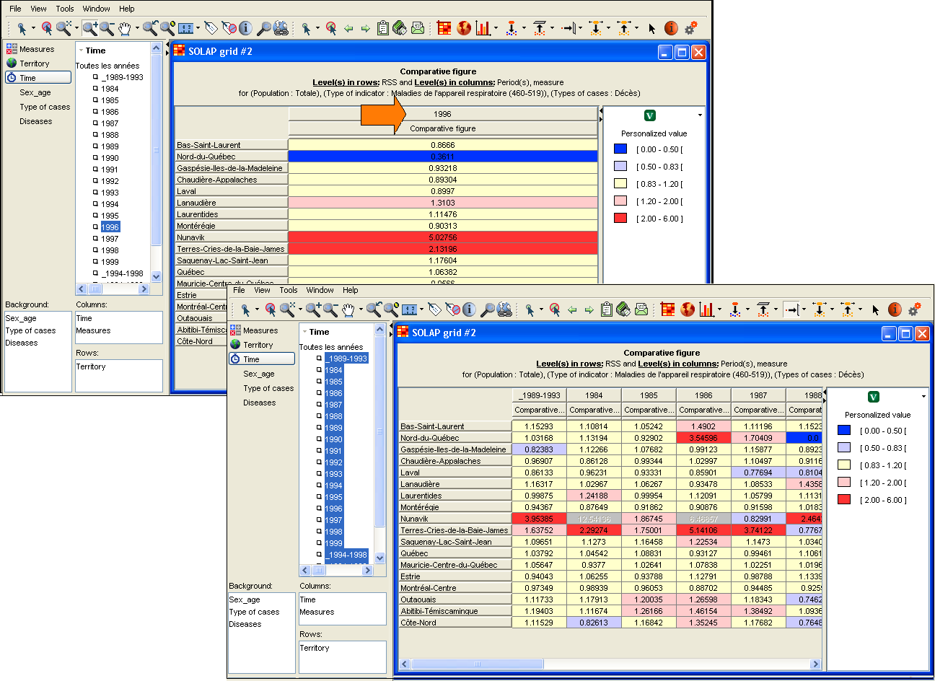
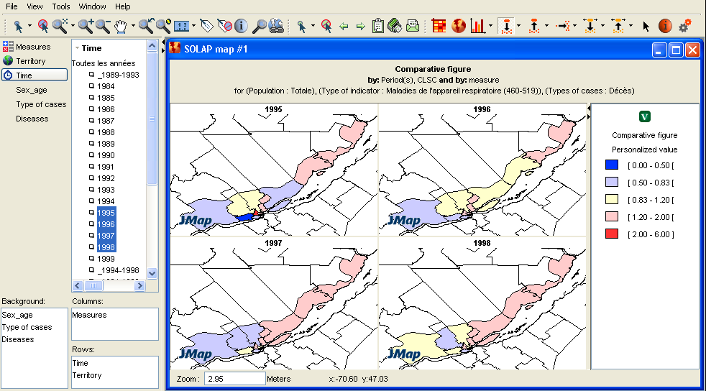
The Power of SOLAP Lies on its Capability to Support Fast and Easy Interactive Exploration of Spatial Data
Select 1 year -> Select all years -> Select 4 years -> Multimap View: 7 clicks, 5 seconds

Slide 19
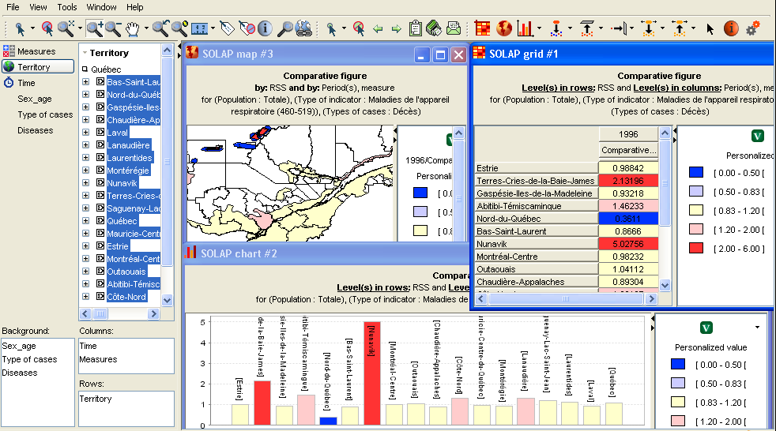
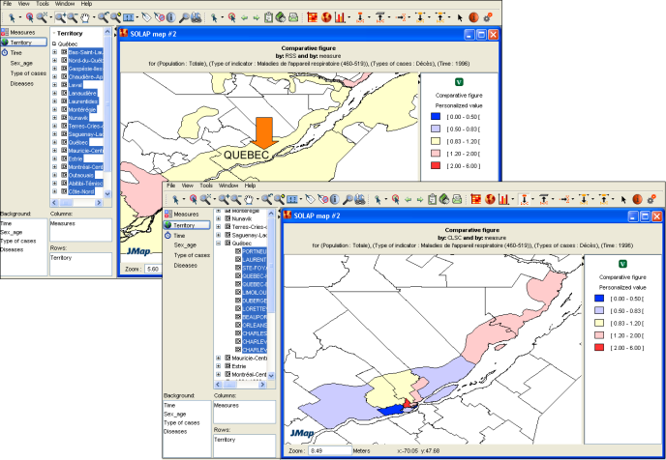
The Power of SOLAP Lies on its Capability to Support Fast and Easy Interactive Exploration of Spatial Data
Select all regions -> Drill-down on one region -> Roll-up -> Show Synchronized Views: 6 clicks, 5 seconds

Slide 20
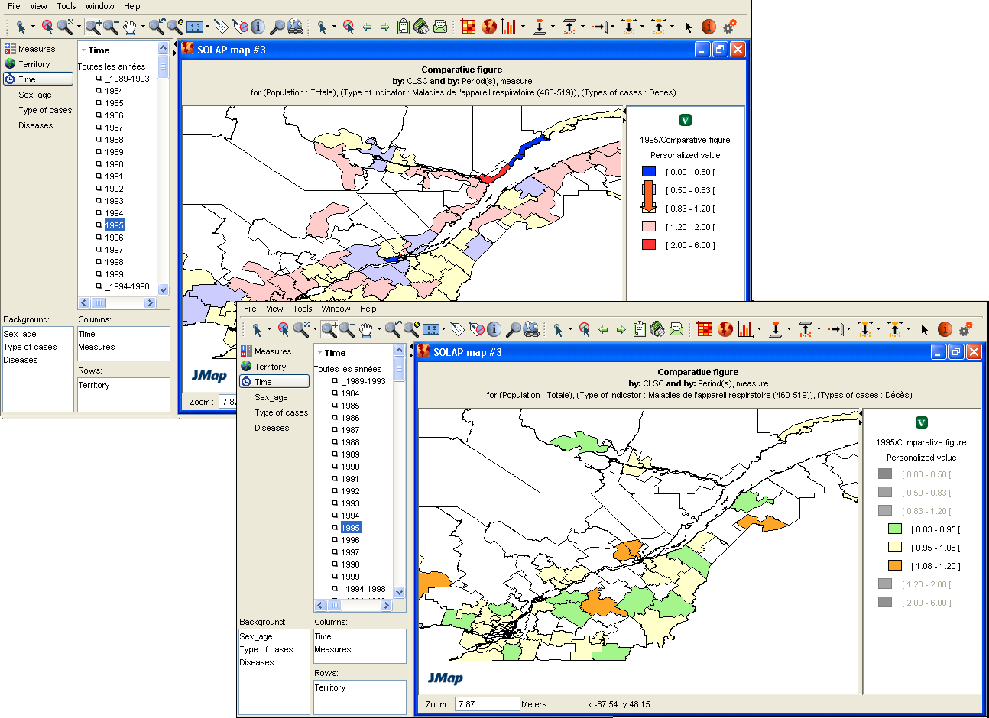
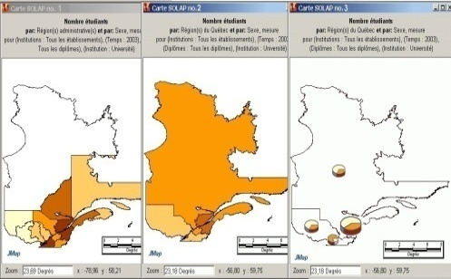
The Power of SOLAP Lies on its Capability to Support Fast and Easy Interactive Exploration of Spatial Data
Change data -> Roll-up -> Roll-up -> Pivot … : 6 click, 5 seconds

Slide 21
A Natural Evolution
Add capabilities to existing systems, don't aim at replacing them
Add value to existing data, no attempt to manage these data
Nature of geospatial data
GIS
SOLAP
Spatial
Non-spatial
DBMS
OLAP
Details Synthesis
Decisional Nature of data

Slide 22
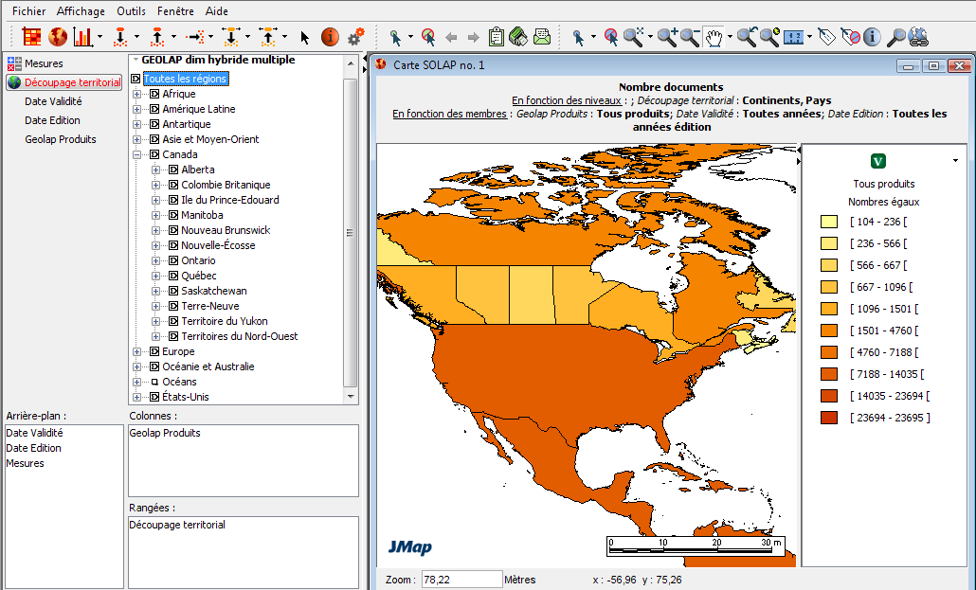
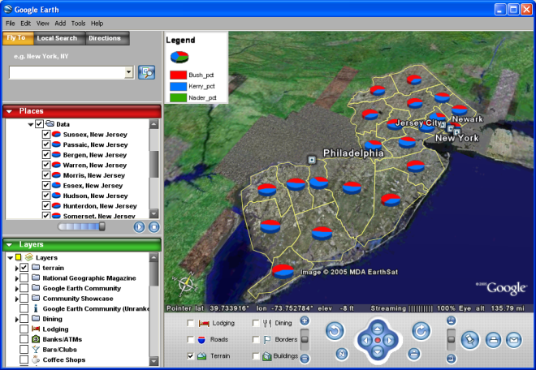
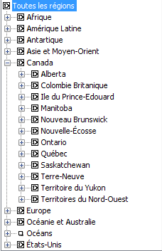
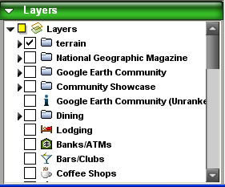
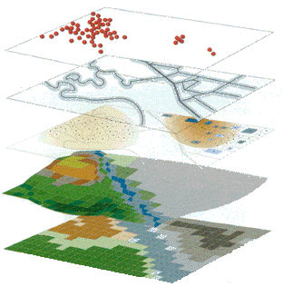
Functionalities: Spatial datacube structure
  Contains spatial dimension organized in a hierarchy
  of spatial members with their geometry
World
Lodging
Streets
Terrain
Elevation
Land use
Countries
Provinces
Map layers
Abstraction
layers
Notes:
To be qualified as a real Spatial OLAP solution, it must include fundamental characteristics that are essential to navigation and cartographic display:
The first basic functionality is necessary to manage and configure the element that compose the spatial data cube.
In order to view spatial members on a map and support drill operations on a spatial dimension, a link must be defined between the spatial members and the corresponding geometries stored in the spatial database. Actually, no intrinsic support for geospatial components exists in well-known datacube structure. Both parts (data and geometries) must thus be manage separately.
For example, a spatial dimension can be defined like this:
The spatial members are associated to their corresponding geometries (see polygons icons in the tree).
The spatial members are grouped into spatial levels (ex. Provinces) .
Spatial levels that form a hierarchy.
This structure supports the intelligence required for the navigation between spatial data.

Slide 23
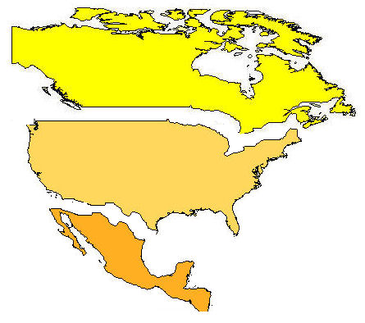
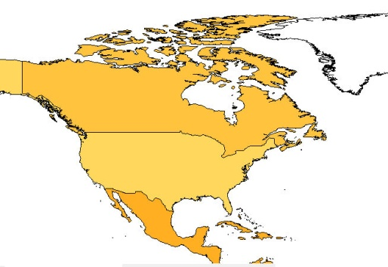
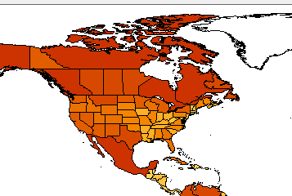
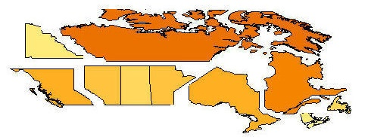
Functionalities: Interactive Exploration supporting the true spirit of data drilling
  Drilling is executed on a member or on a selection of several members (at the same or at different levels of detail of a dimension).
Drilling by members
at different level of details
This is not OLAP drilling !
Country members
Country layer
Canada
Spatial drill on Canada member
Spatial drill on Country layer
Result in province members
of Canada only
Result in opening the entire Province/states layer
Notes:
The second basic functionality is the navigation operator on spatial members.
This kind of operator replicates the operation applied on tables and diagrams of OLAP application on maps.
Spatial drill operators are executed directly by clicking on the elements (dimension members) shown on the maps or on a selection of several elements (at the same or at different levels of detail of a dimension.)
There are different types of spatial drill.
A Spatial drill on a specific member displays only spatial members that are included into the selected member. For example, if user selects Canada region (on the left), the drill operators will result in the display of all Canadian provinces.
Spatial drill by selection allows to select multiple spatial members to drill into at the same time. For example, by selecting United-States and Canada the result will contains states of America and Canadian provinces.
Spatial drill by level displays all spatial members into a spatial level. The operator applied on the country level will display the regional level for all countries of the world. In this example, this includes sub regions for Canada, United-State and South America.

Slide 24
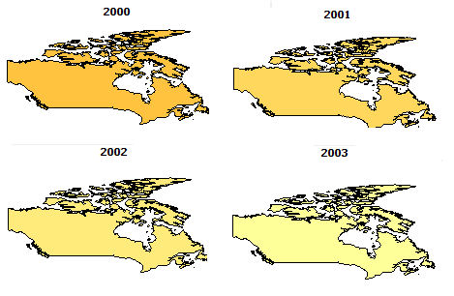
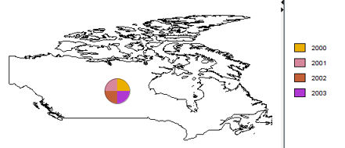
Functionalities: Interactive Exploration
Pivot on map
  Changes the orientation of the dimensions to produce a new display.
  Applied to a map = a different type of map
  Built-in rules must exist to produce the pivoting map corresponding to dimensions selection instantaneously without SQL
One map per year
One row per year
 | Canada
2000
2001
2002
2003
One map for all years
One row for all years
 | 2000 | 2001 | 2002 | 2003
Canada
Notes:
Finally one of the most advanced functionality of some Spatial OLAP solutions is the pivot operator.
The pivot is a useful operation on multidimensional data. Applied on a table, the pivot operator changes the orientation of the dimensions to produce a new display.
Applied on a map, the pivot allows to produce a different type of map.
However, to be successfully applied, precise rules must be defined to produce the pivoted map that corresponds to the active dimension selection.
For example, a multimap per years can be pivoted as a map with superimposed diagrams where years divided the pie chart..

Slide 25
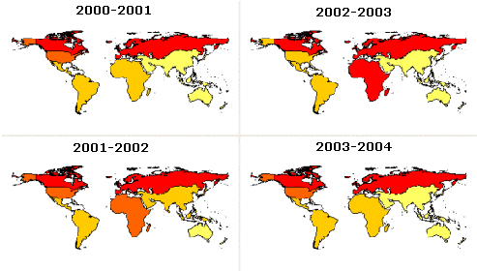
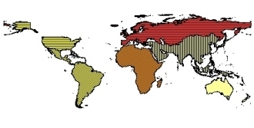
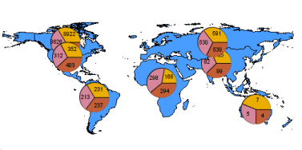
Functionalities: Exploration-Oriented Visualization and advanced maps
  Must support various types of maps (not only choropleth map)
  Advanced maps are used to represent many dimensions or many measures on a map.
  Built-in rules must exist to produce advanced maps instantaneously without SQL.
Temporal multimap
(one map per year)
Map with superimposed diagrams
Multithematic maps
(many members in pie charts)
(one measure/color + one measure/pattern)
Notes:
The more the system supports advanced features, richer the display results will be.
When the system supports complex maps, it can propose alternative displays to view the result.
Commonly, solutions support simple map.
But a wide variety of maps can be used to produce a multidimensional result .
For example, a complex thematic map can be used to display several measures using different thematic values (such as colors or fill patterns)
A temporal multimap is a good way to compare data per years
Finally, map with superimposed diagrams can by used to classify many data values by regions. For example, to display data by age classes.

Slide 26
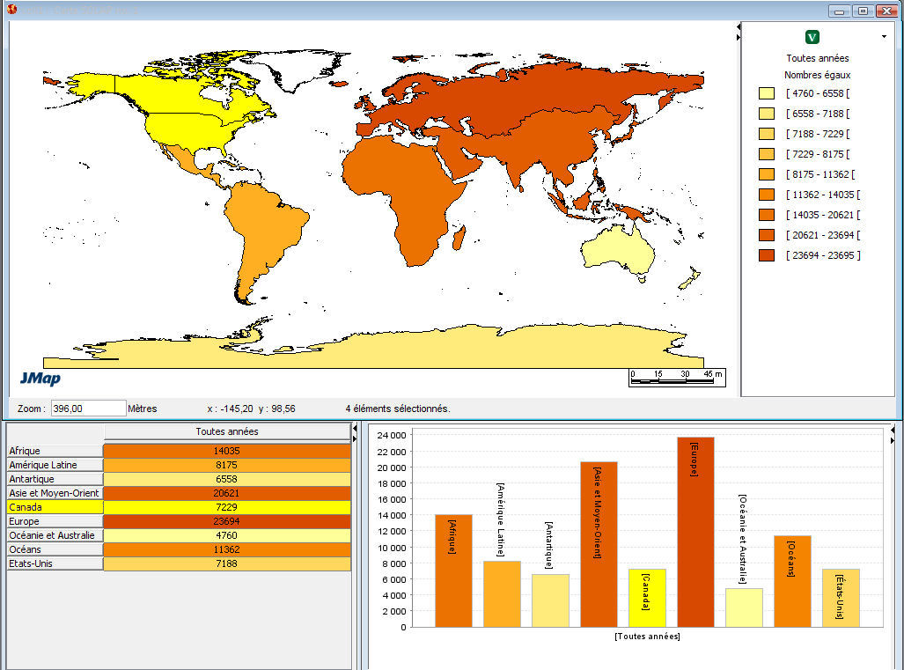
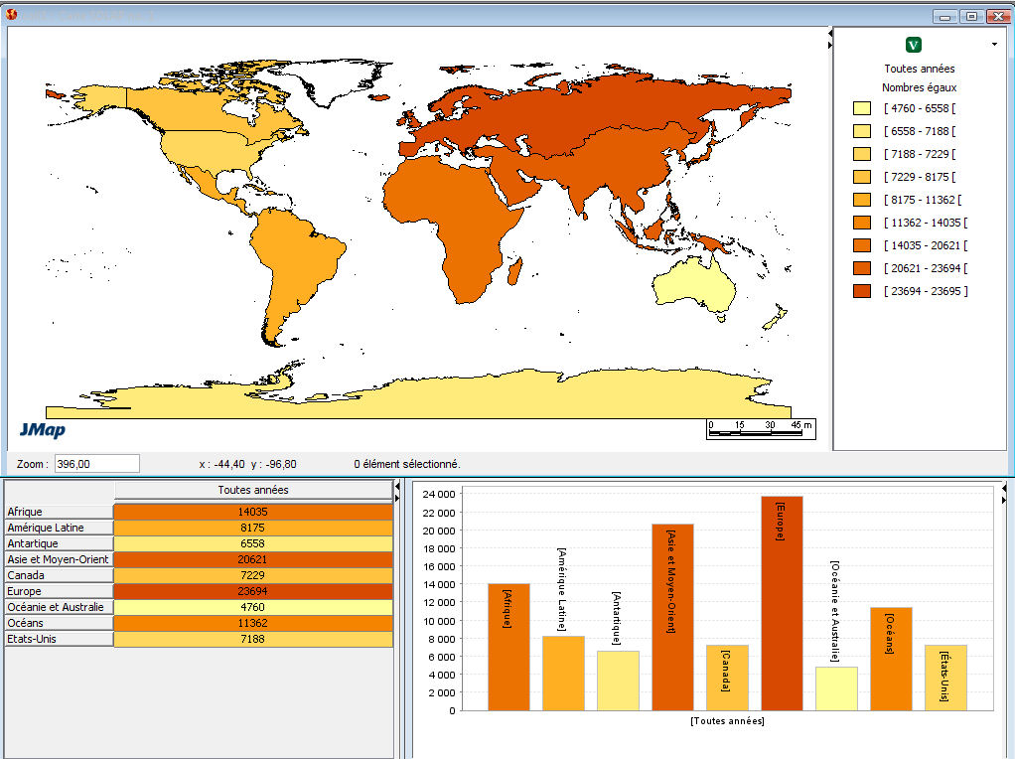
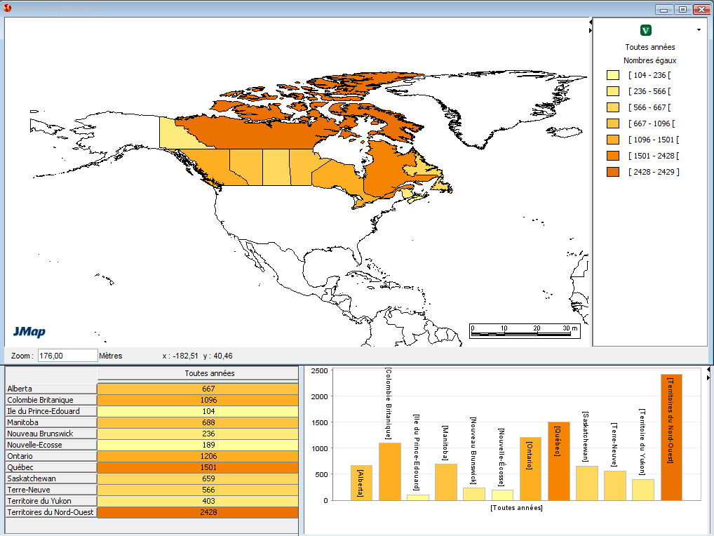
Functionalities: Exploration-oriented Visualization and synchronized displays
An operation on one type of display (e.g. drill, pivot or filter) must automatically replicate on all other types of display (when enabled).
All data per country
Canada
Drill Down
All data per province
Canada
Canada
Provinces
Provinces
Provinces

Slide 27





Functionalities: Exploration-oriented Visualization and intelligent automatic mapping
Intelligent automatic mapping:
  Supports user’s knowledge
  Generates coherent maps by using predefined display rules in accordance to the user’s selection
  Instantaneous display
  No SQL involved
Manual processing:
  Involve specific knowledge by the user (database, semiology, mapping)
  Is time-consuming
What color, symbol , pattern ?
Which advanced map ?
map thematic
classification
display type
Notes:
The more the system supports advanced features, easier will be the user manipulations.
In fact, to improve the knowledge discovery process and help maintain user’s train of thought, a minimal automatization processes are required.
Otherwise too much effort is necessary to build the result.
In a manual map creation, the knowledge must be own by the user (i.e. query language, database structure, graphical semiology).
This kind of process is time-consuming.
In an automatic map creation process the system owns the knowledge. The system generates coherent maps by using predefined display rules. It proposes to the user a display format based on his members and dimensions selection. And the system reapply automatically the active thematic after an operation.
The user have more time to discover data.

Slide 28


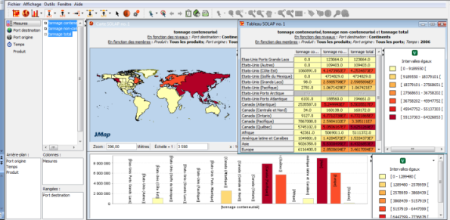
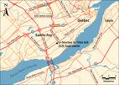







Example of Measured Benefits in a Project for Transport Quebec
M.J.Proulx, Intelli3 (2009)
Annual Report : | Solution géodécisionnelle :
150 maps and tables Static data | 200 000 maps and tables Dynamic applications
Analysis & page editing (3 months-person) Updating (1 month-person) | Data structuration (15 days-person) Updating ( 5 dayx-person)
Ad hoc queries continuously Delays to produce outputs | Application in intranet Fast response
Depend upon an expert in cartography | Easy user interface

Slide 29
Approaches to Develop SOLAP Applications
Ad hoc, proprietary programming specific to one application
Combining GIS + OLAP capabilities
  GIS-centric
  OLAP-centric
  Integrated SOLAP
    Ad hoc programming (ex. using diverse open-source softwares)
    SOLAP technology (the most efficient)
-The dominant tool offers its full capabilities but gets minimal capabilities from the other tool
-GUI provided by the dominant tool

Slide 30
Off-the-Shelf Integrated SOLAP
Facilitates the deployment of a SOLAP application
by offering built-in elements
(e.g. Framework, operators, unique GUI)
Total-integration
capable but
requiring
programming
GIS or
OLAP
Dominant
Total integration
(COTS)
Loosely coupled
Strongly coupled
2 GUI vs common and unique GUI
Built-in integration framework (no need to program the solution)
Offers built-in functionalities to visualize and explore data
No dominant component
30

Slide 31
Video of an Example of SOLAP
Map4Decision (www.intelli3.com)
100% Java
Reads MOLAP and ROLAP datacubes
Reads all popular GIS files
The 1st SOLAP on the market
More than 30 SOLAP-like products exist
  Map4Decision still leads with regards to
    Variety of spatial datacubes
    Multi-platform support
    Integration of BI and GIS concepts
    Ease of installation

Slide 32
Videos

Slide 33
Conclusion
GIS and BI have evolved in silos for many years
R&D bridging both universes started mid-90s
Market is reaching maturity
A scientific community exists
Different application development approaches
    ad hoc
    BI-centric
    GIS-centric
    Integrated
More R&D will bring even better solutions

Slide 34
Thank you !
More info at these web sites:
http://sirs.scg.ulaval.ca/yvanbedard/
http://www.spatialbi.com/
http://mdspatialdb.chair.scg.ulaval.ca/english/Eindex.asp
Technology transfer =
Map4Decision ( www.intelli3.com )

